Slide 1

Digital Transformation Strategy
This presentation introduces a financial model for implementing a digital transformation project aimed at enhancing fan engagement and increasing viewership for the PGA (Professional Golfers Association) Tour.
By Krishna Damarla, 02-05-2025
Notes:
1

Slide 2

The Challenge: Declining Viewership
Younger Audiences
Reduced Revenue
Losing interest in traditional golf broadcasts.
Lower viewership leads to decreased advertising and sponsorship income.
Competition
Alternative entertainment options are capturing attention.
Notes:
2

Slide 3
Proposed Solution: Digital Transformation
Streaming Platform
Interactive Features
E-sports Partnerships
Subscription-based with exclusive content.
Live polls, virtual meet-and-greets, gamified experiences.
Attract younger audiences.
Notes:
3

Slide 4
Financial Model Overview
Evaluate the financial feasibility of the digital transformation project and make informed decisions based on ROI (Return on Investment)
Input Parameters
Initial investment, revenue streams, operating costs.
Decisions
Adjustable parameters, like discount rate, subscription growth rate and advertising revenue.
Calculations
PV (Present Value), FV (Future Value), Time value of money (TVM).
Outputs
Net Present Value (NPV), breakeven analysis.
Notes:
4

Slide 5
Input Parameters
Key parameters (such as, costs & revenue) required to build the financial model
Costs
Initial Investment
Operating Costs
$18 million (technology infrastructure, content creation, marketing)
$3.5 million/year (platform maintenance, content updates, customer support)
Revenue
Sponsorships
Subscription Fees
Advertising Revenue
$3 million/year
$10/month per user
$5 million/year
Notes:
5

Slide 6
Decisions
Key variables that can be adjusted to test the financial model under different conditions. These variables are called decisions as they are human choices that influence financial outcomes.
10%
5%
8%
Subscription Growth
Advertising Growth
Discount Rate
Annually
Annually
Reflecting cost of funds

Slide 7
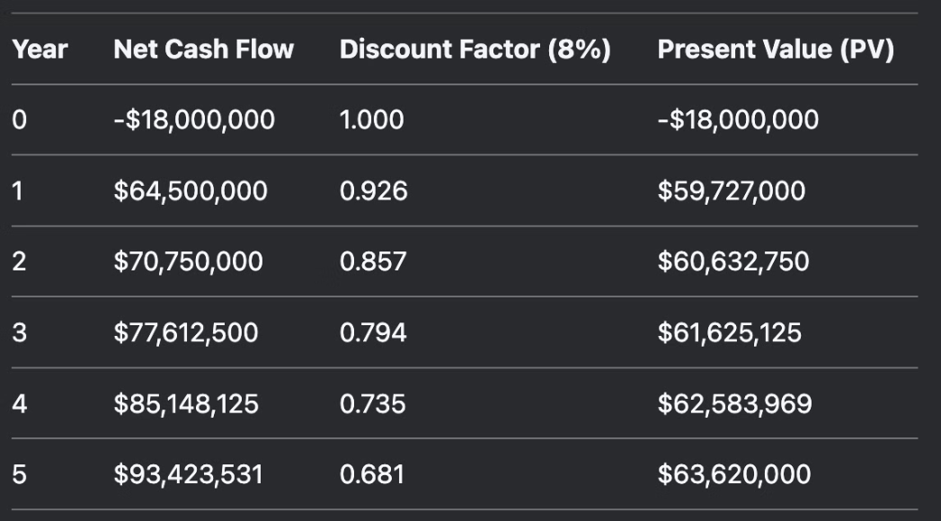
Calculations
Formulas that process input parameters and decisions to generate financial insights (such as, revenue growth over next 5 years)
Calculate Present Value (PV) of initial investment & operating costs
Project future revenue streams using growth rates
Apply the discount rate to calculate PV
Present Value (PV) =
Net Cash Flow * Discount Factor
Net Cash Flow =
Total Revenue - Operating Costs
Discount Factor
- Year 0: = 1 (No discounting for Year 0)
Year 1: = 1 / (1 + Discount Rate)^1
Year 2: = 1 / (1 + Discount Rate)^2
The discount rate helps us to evaluate the profitability (opportunity cost of investing capital) and feasibility of the project. It is an essential factor in determining the present value of future cash flows. Means, it converts future cash flows (money received or spent in the future) into their present value (today's value). Discount rate reflects the time value of money (dollar today is worth more than dollar in the future, as it can be invested to earn a return).
Notes:
3. Calculations (Mathematical Processing)
Definition: These are the formulas and financial equations that process inputs and decisions to generate meaningful financial insights.

Slide 8
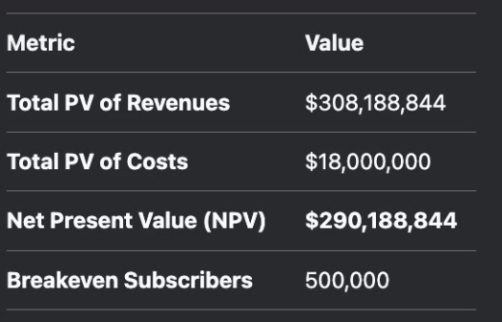
Outputs
Financial results & key findings generated by the financial model
NPV (Net Present Value)
Breakeven Analysis
$290 million (positive, indicating project viability)
Requires 500,000 subscribers to cover costs.
It is calculated as (Total PV of Costs / Revenue per Subscriber of 36$)
Present value of revenues: $308 million (over 5 years)
Present value of costs or Initial Investment: $18 million
NPV = Total PV of Revenues– Total PV of Costs = 308188844 - 18000000 = 290188844
Sensitivity Analysis
Identifies potential risks and uncertainties, to develop contingency plans.
The NPV evaluates project viability. A positive NPV indicates the project is financially feasible (or the project is expected to generate more value than its costs)
Notes:
The NPV calculation evaluates project viability. A positive NPV indicates the project is financially feasible (or the project is expected to generate more value than its costs).

Slide 9

Conclusion
The digital transformation strategy is financially viable, with a positive NPV and strong potential for fan viewership and engagement.
Financial Viability
Next Steps
Call to Action
Positive NPV and strong potential for fan engagement.
Secure funding, develop the platform, and launch a pilot program.
Engage stakeholders to support the initiative.

Slide 10


References
Notes:
10

